Slide 1
Line Drawing Algorithms

Slide 2
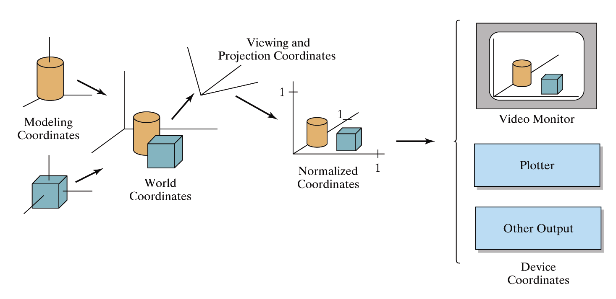
It’s worth taking a little look at how graphics hardware works before we go any further
How do things end up on the screen?

Slide 3
Architecture Of A Graphics System
Display Processor Memory
Frame Buffer
Video Controller
Monitor
Monitor
CPU
Display Processor
System Memory
System Bus

Slide 4
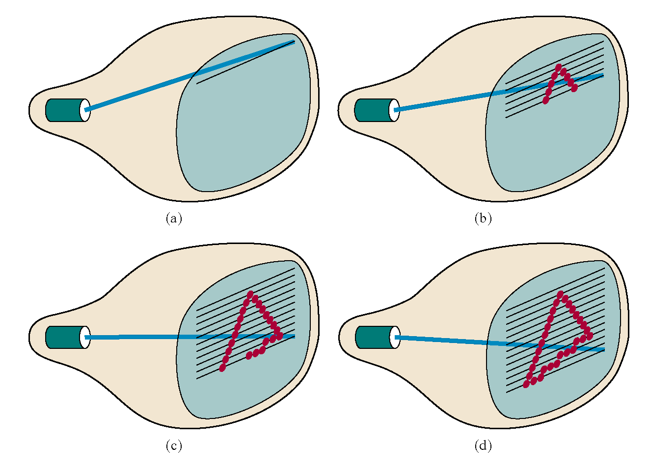
Raster Scan Systems
Draw one line at a time

Slide 5
The Problem Of Scan Conversion
A line segment in a scene is defined by the coordinate positions of the line end-points
y
(7, 5)
(2, 2)
x

Slide 6
Pixel Layout
The line should appear as a straight line and it should start and end accurately
The line should be displayed with a constant brightness along its length, independent of its length and orientation
The line should be drawn rapidly.

Slide 7
The Problem (cont…)
But what happens when we try to draw this on a pixel based display?
How do we choose which pixels to turn on?

Slide 8
Line Equations
Let’s quickly review the equations involved in drawing lines
Slope-intercept line equation:
y
y_{end}
where:
y₀
x₀
x_{end}
x

Slide 9
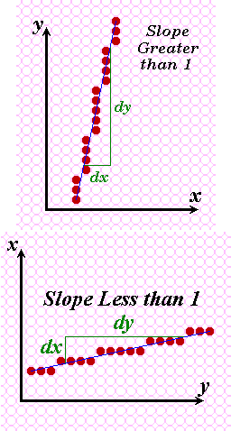

Slide 10
BASIC INCREMENTAL ALGORITHM
(x_{k}+1, round(y_{k}+m))
(x_{k} , y_{k}+m)
(x_{k}+1, y_{k}+m)
(x_{k}, round(y_{k}))

Slide 11
The Basic Incremental Algorithm
slope m =
Δ
y/
Δ
X;
y
i
= mx
i
+ B; y
i+1
= y
i
+ m
Intensify the pixel at (xi
, Round(yi
)).
void line(int x0,int y0,int xn,int yn)
{ // for –1 ≤ m ≤ 1
int x; float m, y;
m = (float) (yn-y0)/(xn-x0);
x=x0; y=y0;
while (x<xn+1) {
// write a pixel into the framebuffer
glBegin(GL_POINTS);
glVertex2i (x, (int) (y+0.5));
glEnd();
x++; y+=m;/* next pixel's position */
}
}

Slide 12
Now just round off the results and turn on these pixels to draw our line
7
6
5
4
3
2
1
0
0
1
2
3
4
5
6
7
8

Slide 13
(x_{k}+1, round(y_{k}+m))
(x_{k}, y_{k}+m)
(x_{k}+1, y_{k}+m)
(x_{k}, round(y_{k}))

Slide 14
DDA Algorithm
DDA (“Digital Differential Analyzer”)
Assume 0 ≤ m ≤ 1 else flip about y= x line.
(x_{i},Round(y_{i}+m))
Desired Line
(x_{i},y_{i})
(x_{i},Round(y_{i}))
(x_{i},y_{i} +m)
void Line(int x0, int y0, int x1, int y1, int value) { double y = y0;
double m = (y1 – y0) / (x0 – x1); // 0 <= m <= 1 for (int x = x0; x <= x1; x++) {
WritePixel(x, Round(y), value);
y += m; }
}
Require to eliminate floating point operations & variables

Slide 15
Midpoint Line Algorithm
d=F(M) > 0 ⇒ A
A
y_{p}+1
C
y_{p}
P=(x_{p},y_{p})
B
x_{p}
x_{p}+1
In mid-point Algorithm, we find on which side of the line the mid point lies.

Slide 16
d=F(M) > 0 ⇒ A
A
C
y_{p}+1
P=(x_{p}, y_{p})
B
y_{p}
x_{p}
x_{p}+1
d=F(M) < 0 ⇒ B
y_{p}+1
A
C
B
y_{p}
P=(x_{p}, y_{p})
x_{p}
x_{p}+1

Slide 17
Midpoint Line Algorithm
Assume
0 ≤ m ≤ 1 [ else flip about y= x line. ]
(x₀, y₀) and (x₁, y₁) are integer values
At each iteration we determine if the line intersects the next pixel above or below its midpoint y value.
if above then NE ⇒ y_{new} = y_{p}+1
otherwise E ⇒ y_{new} = y_{p}
d=F(M) > 0 ⇒ NE
NE
y_{p}+1
M
P=(x_{p}, y_{p})
E
y_{p}
x_{p}
x_{p}+1
d=F(M) < 0 ⇒ E
NE
y_{p}+1
M
P=(x_{p}, y_{p})
E
y_{p}
x_{p}
x_{p}+1

Slide 18
Midpoint Line Algorithm
P=(x_{p}, y_{p}) is pixel chosen by the algorithm in previous step
To calculate d incrementally we require d_{new}
If d > 0 then choose NE
Y_{p}+2
M_{NE}
NE
M
Y_{p}+1
E
y_{p}
P=(x_{p}, y_{p})
x_{p}
x_{p}+1
x_{p}+2
Previous
Current
Next

Slide 19
Midpoint Line Algorithm
If d < 0 then choose E
Y_{p}+2
NE
Y_{p}+1
M
M_{E}
E
y_{p}
P=(x_{p}, y_{p})
x_{p}
x_{p}+1
x_{p}+2
Previous
Current
Next

Slide 20
Midpoint Line Algorithm
To find Initial value of d
NE
M
P=(x₀, y₀)
E
x₀
x₀+1
Only fractional value
Start
Initial d_{o}
Multiply by 2 to avoid fractions. Redefine d₀, ΔE, ΔNE

Slide 21
Midpoint Line Algorithm
void MidpointLine(int x0, int y0, int x1, int y1, int color)
{
int dx = x1 – x0, dy = y1 – y0;
int d = 2*dy – dx;
int dE = 2*dy,
dNE = 2*(dy – dx);
int x = x0, y = y0;
WritePixel(x, y, color);
while (x < x1) {
if (d <= 0) { // Current d
d += dE; // Next d at E
x++;
} else {
d += dNE; // Next d at NE
x++;
y++ } WritePixel(x, y, color);
}
}
NE
(x_{i},y_{i})
M
P=(x_{p}, y_{p})
E
x_{p}
x_{p}+1
x_{p}+2
Previous
Current
Next
NE
(x_{i},y_{i})
M
P=(x_{p}, y_{p})
E
x_{p}
x_{p}+1
x_{p}+2
Previous
Current
Next

Slide 22
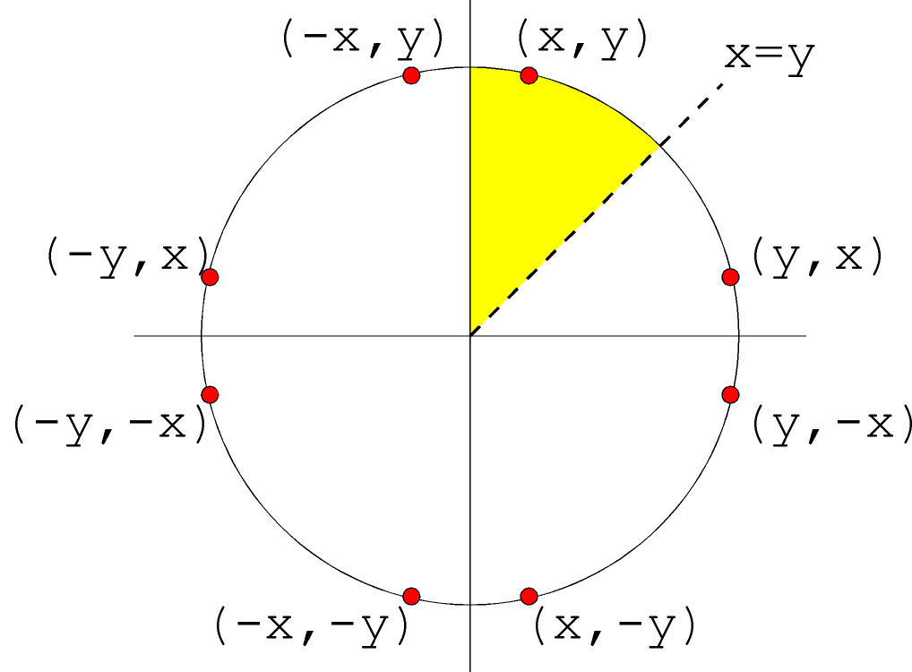
Midpoint Circle Algorithm
Implicit of equation of circle is:
x² + y² - R² = 0
Eight way symmetry ⇒ require to calculate one octant

Slide 23
Midpoint Circle Algorithm
Define decision variable d as:
P=(x_{p}, y_{p})
E
y_{p}
M
M_{E}
y_{p} – 1
SE
M_{SE}
y_{p} – 2
x_{p}
x_{p}+1
x_{p}+2
Next
Previous
Current

Slide 24
P=(x_{p}, y_{p})
E
y_{p}
d < 0
M
M_{E}
y_{p} – 1
y_{p} – 2
x_{p}
x_{p}+1
x_{p}+2
P=(x_{p}, y_{p})
y_{p}
Current
Next
M
Previous
d > 0
y_{p} – 1
SE
M_{SE}
y_{p} – 2
When pixel E is chosen,
x_{p}
x_{p}+1
x_{p}+2
Current
Next
When pixel SE is chosen,

Slide 25
Midpoint Circle Algorithm
If d <= 0 then midpoint m is inside circle
we choose E
Increment x
y remains unchanged
P=(x_{p}, y_{p})
E
y_{p}
M_{E}
d < 0
M
y_{p} – 1
y_{p} – 2
x_{p}
x_{p}+1
x_{p}+2
Next
Previous
Current

Slide 26
Midpoint Circle Algorithm
If d > 0 then midpoint m is outside circle
we choose E
Increment x
Decrement y
P=(x_{p}, y_{p})
y_{p}
d > 0
M
y_{p} – 1
SE
M_{SE}
y_{p} – 2
Previous
x_{p}
x_{p}+1
x_{p}+2
Next
Current

Slide 27
Midpoint Circle Algorithm
Initial condition
Starting pixel (0, R)
Next Midpoint lies at (1, R – ½)
d₀ = F(1, R – ½) = 1 + (R² – R + ¼) – R² = ⁵/₄ – R
To remove the fractional value ⁵/₄ :
Consider a new decision variable h as, h = d – ¼
Substituting d for h + ¼,
d₀=⁵/₄ – R ⇒ h = 1 – R
d < 0 ⇒ h < – ¼ ⇒ h < 0
Since h starts out with an integer value and is incremented by integer value (ΔE or ΔSE), e can change the comparison to just h < 0

Slide 28
Midpoint Circle Algorithm
void MidpointCircle(int radius, int value) { int x = 0;
int y = radius ;
int d = 1.25 – radius ;
CirclePoints(x, y, value);
while (y > x) {
if (d < 0) { /* Select E */
d += 2 * x + 3; } else { /* Select SE */
d += 2 * ( x – y ) + 5;
y – –;
}
x++;
CirclePoints(x, y, value);
}
}

Slide 29
Scan-Line Polygon Fill Algorithm
12
10
D
F
8
E
6
4
C
2
A
B
0
2
4
6
8
10
12
14
16

Slide 30
Scan-Line Polygon Fill Algorithm
12
10
D
F
8
E
6
C
4
A
2
B
0
2
4
6
8
10
12
14
16

Slide 31
o
e
o
e
o
e/o
e

Slide 32
Scan-Line Polygon Fill Algorithm
12
10
D
F
Scan Line
8
w
y
z
x
E
6
C
4
2
A
B
0
2
4
6
8
10
12
14
16

Slide 33
Scan-Line Polygon Fill Algorithm
12
10
D
F
Scan Line
8
w
y
z
x
E
6
C
4
A
2
B
0
2
4
6
8
10
12
14
16

Slide 34
So two important features of scanline polygon filling are
Scanline coherence: scan line values do not change much from one scanline to the next scanline ----the coverage (or visibility ) of a face on the scanline typically differs little from the previous one.
Edge Coherence: edges intersected by scanline”i” are typically inretsected by “i+1”.

Slide 35
12
Draw Bucket sorted edge table.
AET for scan line 4, 6,7,8
10
D
C
8
6
A
4
E
2
B
0
2
4
6
8
10
12
14
16

Slide 36
Draw Bucket sorted edge table.
AET for scan line 1,2,3,5,8
12
F
10
G
8
6
E
4
C
A
2
B
D
0
2
4
6
8
10
12
14
16

Slide 37
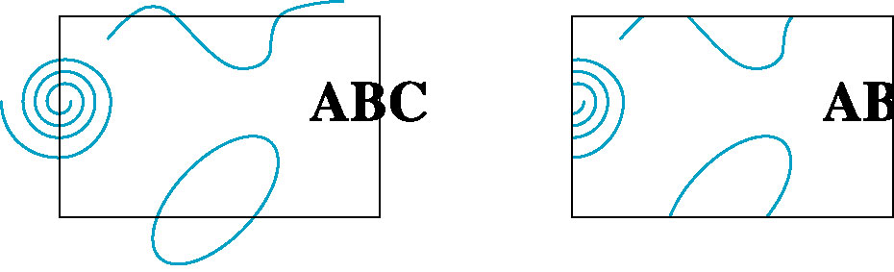
Clipping Area?
Refers to the area that can be seen ( captured by the camera).
Clipping Algorithm/ Clipping?
Generally any procedure that identifies those portions of a picture that are either inside or outside of a specified region of a space is referred to as a Clipping algorithm or clipping.

Slide 38
Clipping Endpoints
For a point (x,y) to be inside the clip rectangle:

Slide 39
Clipping Endpoints
For a point (x,y) to be inside the clip rectangle:

Slide 40
Line Clipping
Cases for clipping lines

Slide 41
Line Clipping
Cases for clipping lines

Slide 42
Line Clipping
Cases for clipping lines

Slide 43
Line Clipping
Cases for clipping lines

Slide 44
Line Clipping
Cases for clipping lines

Slide 45
Line Clipping
Cases for clipping lines

Slide 46
Line Clipping
Clipping Lines by Solving Simultaneous Equations

Slide 47
Cohen-Sutherland Algorithm
The Cohen-Sutherland Line-Clipping Algorithm performs initial tests on a line to determine whether intersection calculations can be avoided.
First, end-point pairs are checked for Trivial Acceptance.
If the line cannot be trivially accepted, region checks are done for Trivial Rejection.
If the line segment can be neither trivially accepted or rejected, it is divided into two segments at a clip edge, so that one segment can be trivially rejected.
These three steps are performed iteratively until what remains can be trivially accepted or rejected.

Slide 48
Cohen-Sutherland Algorithm
Xmin
Xmax
Ymax
Ymin
Region outcodes

Slide 49
Cohen-Sutherland Algorithm
A line segment can be trivially accepted if the outcodes of both the endpoints are zero.
A line segment can be trivially rejected if the logical AND of the outcodes of the endpoints is not zero.
A key property of the outcode is that bits that are set in nonzero outcode correspond to edges crossed.

Slide 50
Cohen-Sutherland Algorithm
An Example

Slide 51
Cohen-Sutherland Algorithm
An Example

Slide 52
Cohen-Sutherland Algorithm
An Example

Slide 53
Cohen-Sutherland Algorithm
An Example

Slide 54
typedef int OutCode;
const int INSIDE = 0; // 0000
const int LEFT = 1; // 0001
const int RIGHT = 2; // 0010
const int BOTTOM = 4; // 0100
const int TOP = 8; // 1000
OutCode ComputeOutCode(double x, double y)
{
OutCode code;
code = INSIDE; // initialised as being inside of clip window
if (x < xmin) // to the left of clip window
code |= LEFT;
else if (x > xmax) // to the right of clip window
code |= RIGHT;
if (y < ymin) // below the clip window
code |= BOTTOM;
else if (y > ymax) // above the clip window
code |= TOP;
return code;
}

Slide 55
void CohenSutherlandLineClipAndDraw(double x0, double y0, double x1, double y1)
{
OutCode outcode0 = ComputeOutCode(x0, y0);
OutCode outcode1 = ComputeOutCode(x1, y1);
bool accept = false;
while (true) {
if (!(outcode0 | outcode1)) { // Bitwise OR is 0. Trivially accept and get out of loop
accept = true; break;
} else if (outcode0 & outcode1) { // Bitwise AND is not 0. Trivially reject and get out of loop
break;
} else {
double x, y;
OutCode outcodeOut = outcode0 ? outcode0 : outcode1;
if (outcodeOut & TOP)
{ // point is above the clip rectangle
x = x0 + (x1 - x0) * (ymax - y0) / (y1 - y0);
y = ymax;
} else if (outcodeOut & BOTTOM) { // point is below the clip rectangle
x = x0 + (x1 - x0) * (ymin - y0) / (y1 - y0);
y = ymin;
}

Slide 56
else if (outcodeOut & RIGHT)
{ // point is to the right of clip rectangle
y = y0 + (y1 - y0) * (xmax - x0) / (x1 - x0);
x = xmax;
}
else if (outcodeOut & LEFT) { // point is to the left of clip rectangle
y = y0 + (y1 - y0) * (xmin - x0) / (x1 - x0);
x = xmin;
}
if (outcodeOut == outcode0) // Now we move outside point to intersection point to clip,and get ready for next pass.
{ x0 = x; y0 = y;
outcode0 = ComputeOutCode(x0, y0); }
else { x1 = x; y1 = y;
outcode1 = ComputeOutCode(x1, y1); }
} // closing of else part
} // while loop
if (accept) {
DrawRectangle(xmin, ymin, xmax, ymax);
LineSegment(x0, y0, x1, y1);
}
} // function end

Slide 57
Liang Barsky Algorithm
Read two end points of line P1 (x1, y1) and P2 (x2, y2)
Read two corner vertices, left top and right bottom of window: (XwMIN, YwMAX) and (XwMAX, YwMIN)
Calculate values of parameters pi and qi for I =1, 2, 3, 4 such that
p1 = -Δx q1 = x1 – XwMIN
p2 = Δx q2 = XwMAX – xi
p3 = – Δy q3 = y1 – YwMIN
p4 = Δy q4 = YwMAX – y1
4) If pi = 0 then, { Line is parallel to ith boundary. If qi < 0 then, { Line is completely outside the boundary. Therefore, discard line segment and Go to Step 10. }

Slide 58
else
{ Check line is horizontal or vertical and accordingly check line end points with corresponding boundaries. If line endpoints lie within the bounded area then use them to draw line. Otherwise use boundary coordinates to draw line. Go to Step 10. } }
5) Initialize t1 = 0 and t2 = t1
6) Calculate values for qi/pi for i= 1,2,3,4
7) Select values of qi/pi where pi<0 and assign maximum out of them as t1.
8) Select values of qi/pi where pi>0 and assign maximum out of them as t2.
9) If (t1 < t2) {
Calculate endpoints of clipped line: xx1 = x1 + t1 Δx xx2 = x1 + t2 Δx yy1 = y1 + t1 Δy yy2 = y1 + t2 Δy Draw line (xx1, yy1, xx2, yy2)
}
10) STOP

Slide 59
float xmin,ymin,xmax,ymax;
double xvmin=100,yvmin=100,xvmax=200,yvmax=200;
int x0,x1,y1,y0;
int cliptest(double p,double q,double *t1,double *t2)
{
double t=q/p;
if(p<0.0)
{
if(t>*t1) *t1=t;
if(t>*t2) return(false);
}
else if(p>0.0)
{
if(t<*t2) *t2=t;
if(t<*t1) return(false);
}
else if(p==0.0)
{
if(q<0.0) return(false);
}
return(true);
}

Slide 60
void LiangBarskyLineClipAndDraw(double x0,double y0,double x1,double y1)
{
double dx=x1-x0,dy=y1-y0,ti=0.0,te=1.0;
if(cliptest(-dx,x0-xmin,&ti,&te))
if(cliptest(dx,xmax-x0,&ti,&te))
if(cliptest(-dy,y0-ymin,&ti,&te))
if(cliptest(dy,ymax-y0,&ti,&te))
{
if(ti>0.0)
{
x0=x0+ti*dx;
y0=y0+ti*dy;
}
if(te<1.0)
{
x1=x0+te*dx;
y1=y0+te*dy;
}
Drawline(x0,y0,x1,y1);
}
}
Trace the algorithm for a line from( 50,120) to (150,170)

Slide 61
Clipping Polygons
Clipping polygons is more complex than clipping the individual lines
Input: polygon
Output: original polygon, new polygon, or nothing

Slide 62
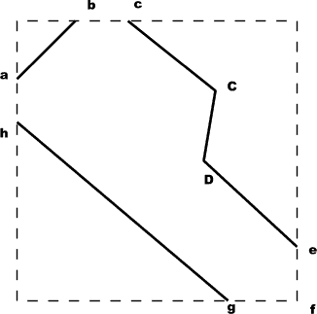
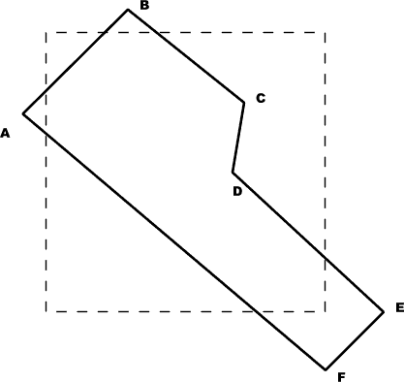
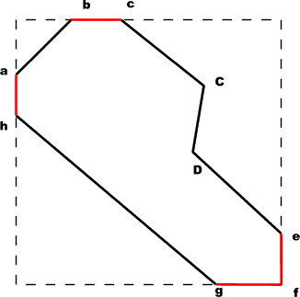
Polygon Clipping done by line clipping Algorithm
Before Clipping
Modifying the line clipping algorithm

Slide 63
Why Is Clipping Hard?
What happens to a triangle during clipping?
Possible outcomes:
triangle ⇨ triangle
triangle ⇨ quad
triangle ⇨ 5-gon
How many sides can a clipped triangle have?

Slide 64
How many sides?
Seven…

Slide 65
Polygon Fill-Area Clipping

Slide 66
Polygon Fill-Area Clipping
v1
v1’
v1”
v3’
v3
v3”
v2
v2
Note: Need to consider each of 4 edge boundaries

Slide 67
Why Is Clipping Hard?
A really tough case:

Slide 68
Why Is Clipping Hard?
A really tough case:
concave polygon ⇨ multiple polygons

Slide 69
Sutherland-Hodgeman Clipping
Basic idea:
Consider each edge of the viewport individually
Clip the polygon against the viewport edge’s equation

Slide 70
Sutherland-Hodgeman Clipping
Basic idea:
Consider each edge of the viewport individually
Clip the polygon against the edge equation to produce new sequence of vertices. The new set of vertices could then be successively passed.
After doing all edges, the polygon is fully clipped

Slide 71
Sutherland-Hodgeman Clipping
Basic idea:
Consider each edge of the viewport individually
Clip the polygon against the edge equation to produce new sequence of vertices. The new set of vertices could then be successively passed.
After doing all edges, the polygon is fully clipped

Slide 72
Sutherland-Hodgeman Clipping
Basic idea:
Consider each edge of the viewport individually
Clip the polygon against the edge equation to produce new sequence of vertices. The new set of vertices could then be successively passed.
After doing all edges, the polygon is fully clipped

Slide 73
Sutherland-Hodgeman Clipping
Basic idea:
Consider each edge of the viewport individually
Clip the polygon against the edge equation to produce new sequence of vertices. The new set of vertices could then be successively passed.
After doing all edges, the polygon is fully clipped

Slide 74
Sutherland-Hodgeman Clipping
Basic idea:
Consider each edge of the viewport individually
Clip the polygon against the edge equation to produce new sequence of vertices. The new set of vertices could then be successively passed.
After doing all edges, the polygon is fully clipped

Slide 75
Sutherland-Hodgeman Clipping
Basic idea:
Consider each edge of the viewport individually
Clip the polygon against the edge equation to produce new sequence of vertices. The new set of vertices could then be successively passed.
After doing all edges, the polygon is fully clipped

Slide 76
Sutherland-Hodgeman Clipping
Basic idea:
Consider each edge of the viewport individually
Clip the polygon against the edge equation to produce new sequence of vertices. The new set of vertices could then be successively passed.
After doing all edges, the polygon is fully clipped

Slide 77
Sutherland-Hodgeman Clipping
Basic idea:
Consider each edge of the viewport individually
Clip the polygon against the edge equation to produce new sequence of vertices. The new set of vertices could then be successively passed.
After doing all edges, the polygon is fully clipped

Slide 78
Sutherland-Hodgeman Clipping: The Algorithm
Basic idea:
Consider each edge of the viewport individually
Clip the polygon against the edge equation to produce new sequence of vertices. The new set of vertices could then be successively passed.
After doing all edges, the polygon is fully clipped

Slide 79
Sutherland-Hodgeman Clipping
Input/output for algorithm:
Input: list of polygon vertices in order
Output: list of clipped polygon vertices consisting of old vertices (maybe) and new vertices (maybe)
Note: this is exactly what we expect from the clipping operation against each edge
( each edge of the polygon is individually compared with the clipping plane)

Slide 80
Sutherland-Hodgeman Clipping
Sutherland-Hodgman basic routine:
Go around polygon one vertex at a time
Current vertex has position p
Previous vertex had position s, and it has been added to the output if appropriate

Slide 81
Sutherland-Hodgeman Clipping
Edge from s to p takes one of four cases:
inside
outside
inside
outside
inside
outside
inside
outside
p
s
p
s
p
s
p
s
p output
i output
no output
i output p output

Slide 82
Sutherland-Hodgeman Clipping
Four cases:
s inside plane and p inside plane
Add p to output
Note: s has already been added
s inside plane and p outside plane
Find intersection point i
Add i to output
s outside plane and p outside plane
Add nothing
s outside plane and p inside plane
Find intersection point i
Add i to output, followed by p

Slide 83
typedef point vertex; //point holds double x,y;
typedef vertex edge[2];
typedef vertex vertexArray[max];
Static void Output(vertex newVertex, int *outLength, vertexArray outVertexArray)
{
Adds newVertex to outVertexArray and then updates outLength;
}
Static boolean Inside(vertex testVertex, edge clipBoundary)
{
Checks whether the vertex lies inside the clip edge or not;
Returns true if its inside else returns false;
}
Static vertex Intersect(vertex first, vertex second, edge clipBoundary)
{
Clips polygon edge (first, second) against clipBoundary, outputs the new point;
}

Slide 84
Void SutherlandHodgmanPolygonClip(vertexArray inVertexArray, vertexArray outVertexArray,
int inLength, int*outLength, edge clipBoundary)
{
vertex s,p,i;
int j;
*outLength=0;
s=inVertexArray[inlength-1]; //starts with last vertex in inVertexArray;
for(j=0;j<inLength;j++)
{
P=inVertexArray[j];
If(Inside(p,clipBoundary)) // case 1 and case 4;
{
if(Inside(s,clipBoundary)) // case 1;
Output(p,outLength,outVertexArray);
else //case 4;
{
i=Intersect(s,p,clipBoundary);
Output(i,outLength,outVertexArray);
Output(p,outLength,outVertexArray);
} }
elseif (Inside(s,clipBoundary)) //case 2;
{
i=Intersect(s,p,clipBoundary);q
Output(i,outLength,OutVertexArray);
}
s=p;
} }

